Slide 1
Software Engineering
Sobia Iftikhar
Sobia.Iftikhar@nu.edu.pk
Week 09

Slide 2
Class 28 29-APRIAL-2021 presentation

Slide 3
Class 29 29-APRIAL-2021

Slide 4
Software Testing
Development testing
Test-driven development
Release testing
User testing

Slide 5
Objectives
understand the stages of testing from testing during development to acceptance testing by system customers;
have been introduced to techniques that help you choose test cases that are geared to discovering program defects;
understand test-first development, where you design tests before writing code and run these tests automatically;
know about three distinct types of testing—component testing, system testing, and release testing;
understand the distinctions between development testing and user testing

Slide 6
Testing
what it is intended to do and to discover program defects before it is put into use.
When you test software, you execute a program using artificial data.
You check the results of the test run for errors, anomalies, or information about the program’s non-functional attributes.

Slide 7
When you test software, you are trying to do two things:
1.Demonstrate to the developer and the customer that the software meets its requirements.
For custom software, this means that there should be at least one test for every requirement in the requirements document
For generic software products, it means that there should be tests for all of the system features that will be included in the product release. You may also test combinations of features to check for unwanted interactions between them.
Testcase
R1
R2
R3
Testcase
R1
Testcase
Testcase

Slide 8
When you test software, you are trying to do two things:
2. To discover situations in which the behavior of the software is incorrect, undesirable or does not conform to its specification.
Defect testing is concerned with rooting out undesirable system behavior such as system crashes, unwanted interactions with other systems, incorrect computations and data corruption.

Slide 9
Testing process goals
Validation testing
To demonstrate to the developer and the system customer that the software meets its requirements
A successful test shows that the system operates as intended.
Defect testing
To discover faults or defects in the software where its behavior is incorrect or not in conformance with its specification
A successful test is a test that makes the system perform incorrectly and so exposes a defect in the system.

Slide 10
An input-output model of program testing

Slide 11
Verification vs validation
Verification: "Are we building the product right”.
The software should conform to its specification.
Validation: "Are we building the right product”.
The software should do what the user really requires.

Slide 12
Verification vs validation
A clickable button with name Submit
Verification would check the design doc and correcting the spelling mistake.
Otherwise, the development team will create a button like
A clickable button with name Submit
Once the code is ready, Validation is done. A Validation test found –

Slide 13
V & V confidence
Aim of V & V is to establish confidence that the system is ‘fit for purpose’.
Depends on system’s purpose, user expectations and marketing environment
Software purpose
The level of confidence depends on how critical the software is to an organisation.
User expectations
Users may have low expectations of certain kinds of software.
Marketing environment
Getting a product to market early may be more important than finding defects in the program.

Slide 14
Inspections and testing
Software inspections Concerned with analysis of the static system representation to discover problems (static verification)
May be supplement by tool-based document and code analysis.
Software testing Concerned with exercising and observing product behaviour (dynamic verification)
The system is executed with test data and its operational behaviour is observed.

Slide 15
Inspections and testing

Slide 16
Software inspections
These involve people examining the source representation with the aim of discovering anomalies and defects.
Inspections not require execution of a system so may be used before implementation.
They may be applied to any representation of the system (requirements, design,configuration data, test data, etc.).
They have been shown to be an effective technique for discovering program errors.

Slide 17
Advantages of inspections
During testing, errors can mask (hide) other errors. Because inspection is a static process, you don’t have to be concerned with interactions between errors.
Incomplete versions of a system can be inspected without additional costs. If a program is incomplete, then you need to develop specialized test harnesses to test the parts that are available.
As well as searching for program defects, an inspection can also consider broader quality attributes of a program, such as compliance with standards, portability and maintainability.

Slide 18
Inspections and testing
Inspections and testing are complementary and not opposing verification techniques.
Both should be used during the V & V process.
Inspections can check conformance with a specification but not conformance with the customer’s real requirements.
Inspections cannot check non-functional characteristics such as performance, usability, etc.

Slide 19
A model of the software testing process

Slide 20
Stages of testing
Development testing, where the system is tested during development to discover bugs and defects.
Release testing, where a separate testing team test a complete version of the system before it is released to users.
User testing, where users or potential users of a system test the system in their own environment.

Slide 21
Development testing
Development testing includes all testing activities that are carried out by the team developing the system.
Unit testing,
where individual program units or object classes are tested. Unit testing should focus on testing the functionality of objects or methods.
Component testing,
where several individual units are integrated to create composite components. Component testing should focus on testing component interfaces.
System testing,
where some or all of the components in a system are integrated and the system is tested as a whole. System testing should focus on testing component interactions.

Slide 22
Development testing
Development testing is primarily a defect testing process, where the aim of testing is to discover bugs in the software.
It is therefore usually interleaved with debugging—the process of locating problems with the code and changing the program to fix these problems

Slide 23
Class 30 30-APRIAL-2021

Slide 24
Unite-Testing
Unit testing is the process of testing program components, such as methods or object classes.
Individual functions or methods are the simplest type of component.
Your tests should be calls to these routines with different input parameters.
Units may be:
Individual functions or methods within an object
Object classes with several attributes and methods
Composite components with defined interfaces used to access their functionality.

Slide 25
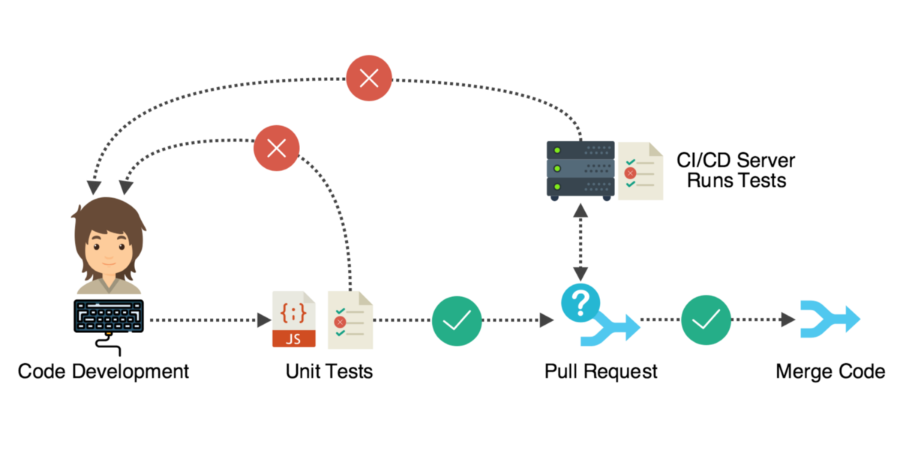
Unite-Testing

Slide 26
Object class testing
Complete test coverage of a class involves
Testing all operations associated with an object
Setting and interrogating all object attributes
Exercising the object in all possible states.
Inheritance makes it more difficult to design object class tests as the information to be tested is not localised.

Slide 27
The weather station object interface

Slide 28
Weather station testing
Need to define test cases for reportWeather, calibrate, test, startup and shutdown.
Using a state model, identify sequences of state transitions to be tested and the event sequences to cause these transitions
For example:
Shutdown -> Running-> Shutdown
Configuring-> Running-> Testing -> Transmitting -> Running
Running-> Collecting-> Running-> Summarizing -> Transmitting -> Running

Slide 29
How to do Unit Testing
Manual
Automated

Slide 30
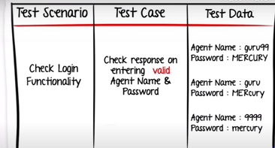
Manual-Testing

Slide 31
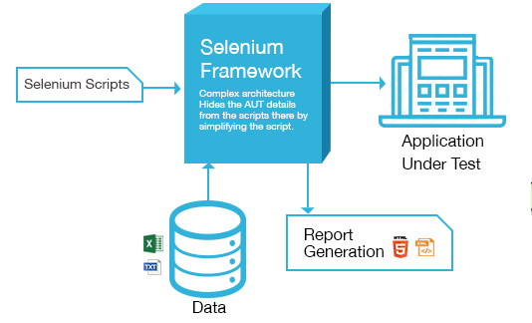
Automated-testing

Slide 32
Automated test components
A setup part, where you initialize the system with the test case, namely the inputs and expected outputs.
A call part, where you call the object or method to be tested.
An assertion part where you compare the result of the call with the expected result. If the assertion evaluates to true, the test has been successful if false, then it has failed.

Slide 33
Choosing unit test cases
The test cases should show that, when used as expected, the component that you are testing does what it is supposed to do.
If there are defects in the component, these should be revealed by test cases.
This leads to 2 types of unit test case:
The first of these should reflect normal operation of a program and should show that the component works as expected.
The other kind of test case should be based on testing experience of where common problems arise. It should use abnormal inputs to check that these are properly processed and do not crash the component.

Slide 34
Two strategies that can be effective in helping you choose test cases are:
1. Partition testing, where you identify groups of inputs that have common charac teristics and should be processed in the same way. You should choose tests from within each of these groups.
2. Guideline-based testing, where you use testing guidelines to choose test cases. These guidelines reflect previous experience of the kinds of errors that program- mers often make when developing components.

Slide 35
Partition testing
Input data and output results often fall into different classes where all members of a class are related.
Each of these classes is an equivalence partition or domain where the program behaves in an equivalent way for each class member.
Test cases should be chosen from each partition.

Slide 36
Equivalence partitioning

Slide 37
Equivalence partitions

Slide 38
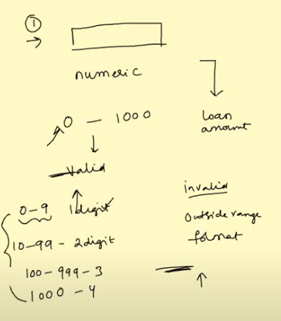
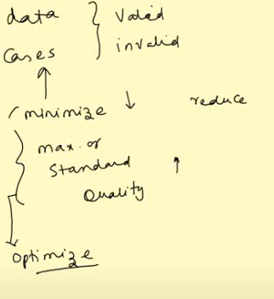
Equivalence partitions

Slide 39
guidelines that could help reveal defects include:
1. Test software with sequences that have only a single value. Programmers naturally think of sequences as made up of several values, and sometimes they embed this assumption in their programs. Consequently, if presented with a single-value sequence, a program may not work properly.
2. Use different sequences of different sizes in different tests. This decreases the chances that a program with defects will accidentally produce a correct output because of some accidental characteristics of the input.
3. Derive tests so that the first, middle, and last elements of the sequence are accessed. This approach reveals problems at partition boundaries.

